Slide 1


Bartabahok - A Fault Tolerant Chat Application

Slide 2

CONTENTS
Members
1. Project Overview
2. Problem Domain & Motivation
3. Project Features
4. Tools & Technologies
5. Future Enhancements
6. Output Screenshots
7. Block Diagram/Work Flow Diagram
8. Applied Networking Concepts with Corresponding Codes
9. Limitations and Future Plans
10. Conclusion

Slide 3



01
Members

Slide 4


Members
1
Mehedi Hasan Sakib (Roll-13)
2
Md. Abu Kawser (Roll-33)

Slide 5

02
Project Overview

Slide 6

Project Title
Bartabahok – Fault-Tolerant JavaFX Chat Application with Multimedia and SQLite Support

Slide 7

Summary
Bartabahok is a robust cross-platform chat application developed in Java using JavaFX and SQLite. It ensures reliable TCP communication with automatic retransmission, supports multiple concurrent message flows, and features a modern GUI with timestamps. The application allows text chat, file sharing (including images and documents), voice messages, emoji-based message reactions, and user tagging/mentioning. It supports both private and group chats, includes a user search bar, and uses SQLite for persistent chat and user data storage.

Slide 8

03
Problem Domain & Motivation

Slide 9

Challenges
Most desktop chat applications lack fault tolerance, offline message buffering, or user interaction features like reactions and voice messaging.

Slide 10





Solutions Offered
A fault-tolerant network layer with automatic retransmission.
Support for multimedia (files, images, voice).
Real-time message reactions and tagging for better collaboration.
A rich GUI interface using JavaFX with message timestamps.
Group chat and mention system to organize communication efficiently.

Slide 11


Key Features
Reliable Messaging: Ensure that all messages are delivered using retransmission if delivery fails.
Real-Time Timestamps: Display sending and receiving times for each message.
Concurrent Communication: Handle multiple chat threads via multithreading.
File Uploading: Support sending of images, PDFs, documents, videos, and audio clips.
Group Chats: Allow communication in named chat rooms with user join/leave capability.
Message Reactions: Enable users to react to messages with emojis.
Tagging & Mentions: Use @username syntax to notify or highlight users.
Voice Messages: Record and send voice messages; allow playback in the chat interface.
Acknowledgment System: Display delivery status for each message.
Search Users: Integrate a search bar to filter users by name or group.
Persistent Storage: Use SQLite to store messages, metadata, and user information.

Slide 12

04
Project Features

Slide 13



Project Features
JavaFX GUI
Reliable TCP Socket Layer
Multimedia Support
• Responsive interface with scrollable chat, reactions, mentions, and voice controls.
• Upload/download images, videos, documents, and voice messages.
• Retransmit undelivered messages until acknowledged.
Voice Messaging
Emoji Reactions
@Mentions & Tagging
• Record using microphone and send/play audio snippets inside chat.
• Users can react to any message using preset emojis.
• Highlight or notify specific users using @username syntax.
Group Chat Rooms
Search Bar
Message Timestamps & Status
• Real-time communication in multiple concurrent chat groups.
• Filter users and groups dynamically by name.
• Show time of send/receive with delivery status.
Data Persistence
• SQLite handles user records, chat history, files, and voice logs.

Slide 14

05
Tools & Technologies

Slide 15

Tools & Technologies
Java 17
JavaFX
Programming language for backend logic.
GUI toolkit for desktop interfaces.
SQLite
javax.sound.sampled
Lightweight relational database.
For voice recording/playback.
java.net
Multithreading
Socket programming for chat protocols.
Used for simultaneous communication and audio recording.
CSS
Combined with JavaFX for better and lucrative UI.

Slide 16

06
Future Enhancements

Slide 17


Future Enhancements
Full encryption using AES or TLS sockets.
Cross-device mobile app version (Flutter or Kotlin).
Push notifications for offline messages.
Voice/video calling via WebRTC.
Admin-controlled chat rooms.

Slide 18
07
Output Screenshots

Slide 19

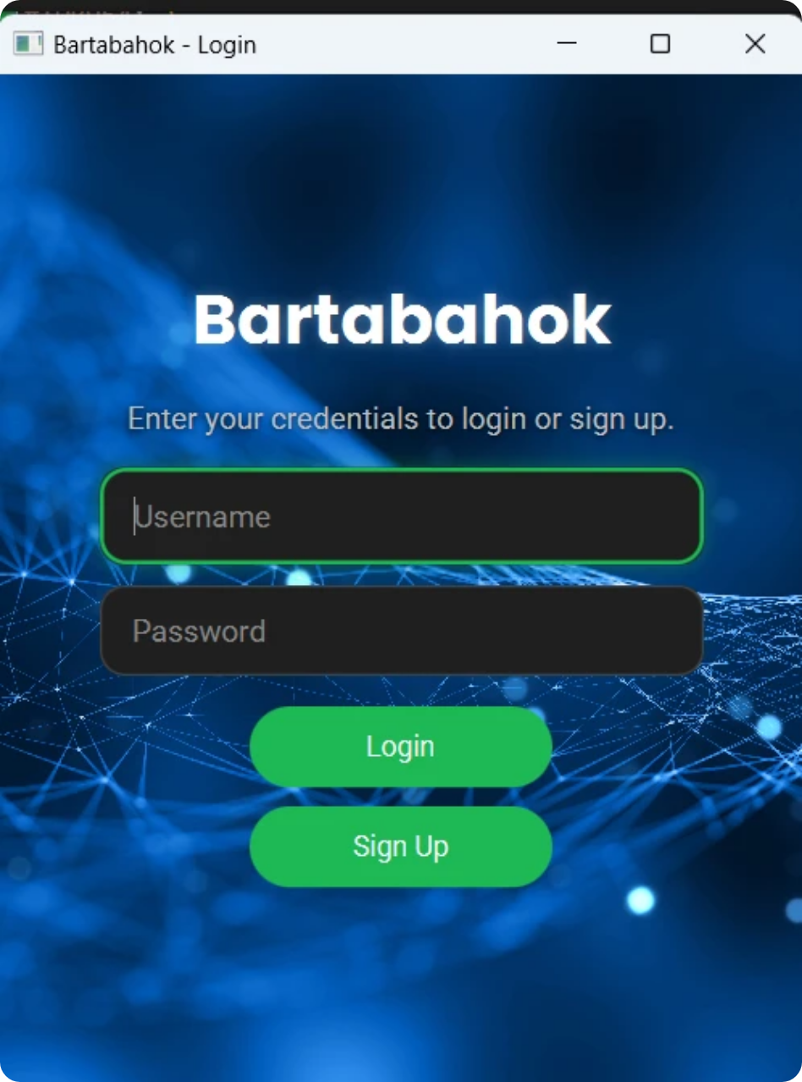
Login and Signup Page
Username and password required for login and signup.

Slide 20

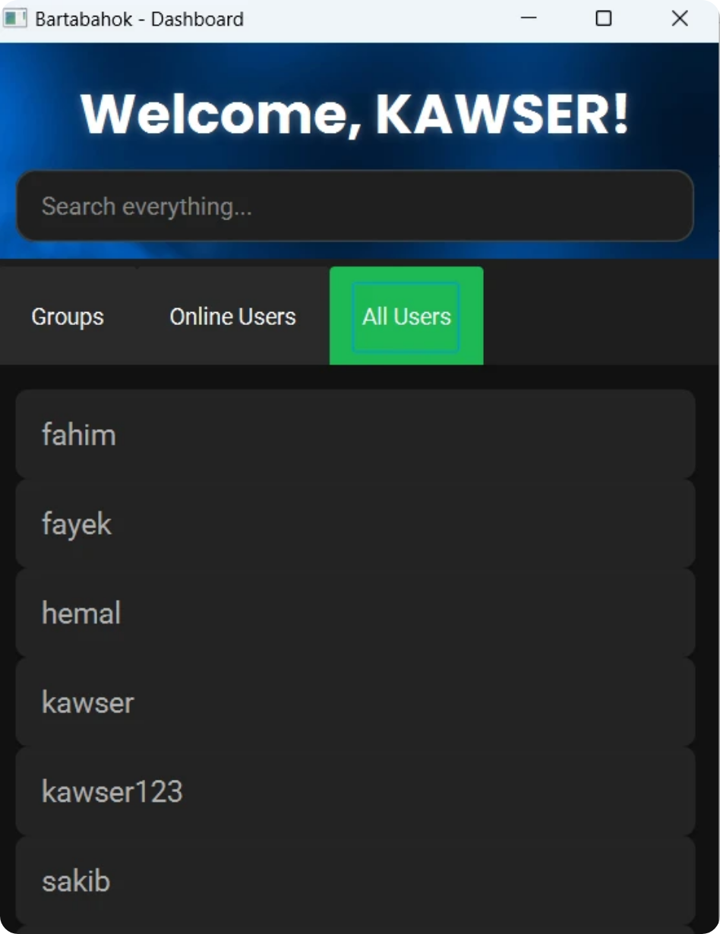
Dashboard Page
Consisting of all groups, online users, and all users tab.

Slide 21

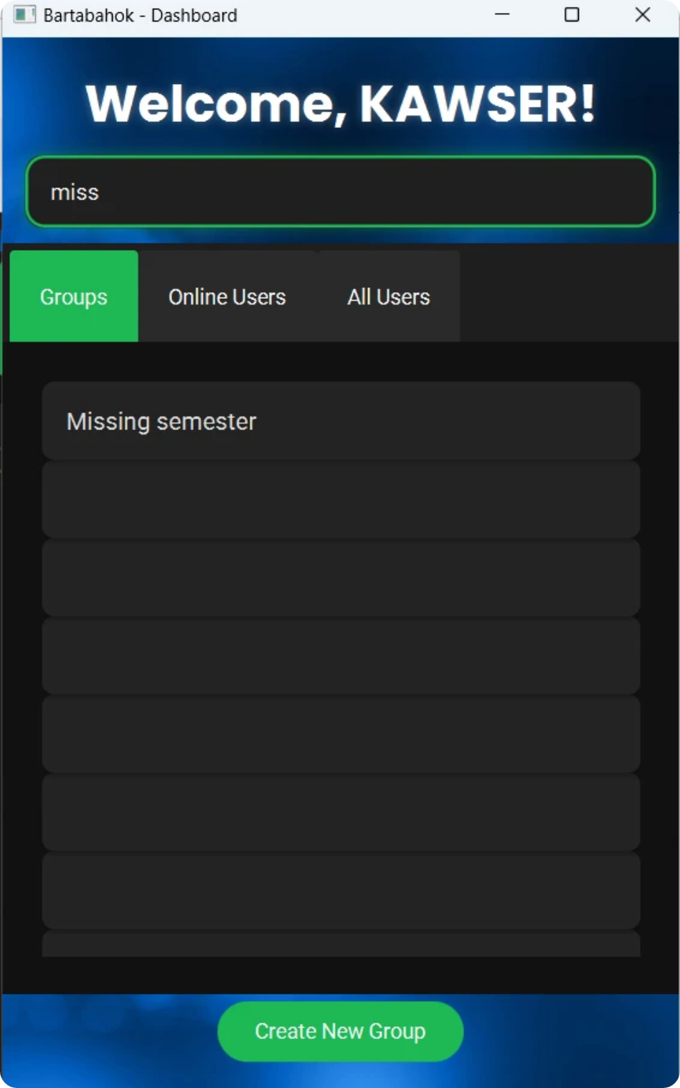
Search Functionality
All online users list with active now button enabled.

Slide 22
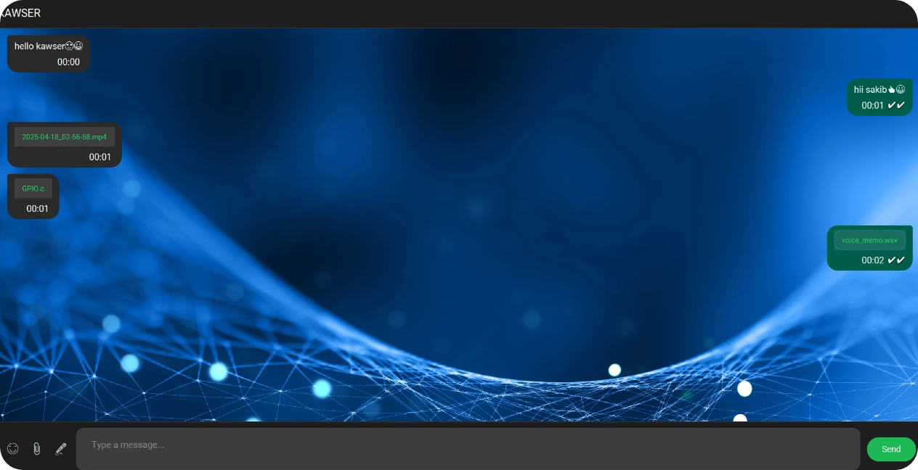
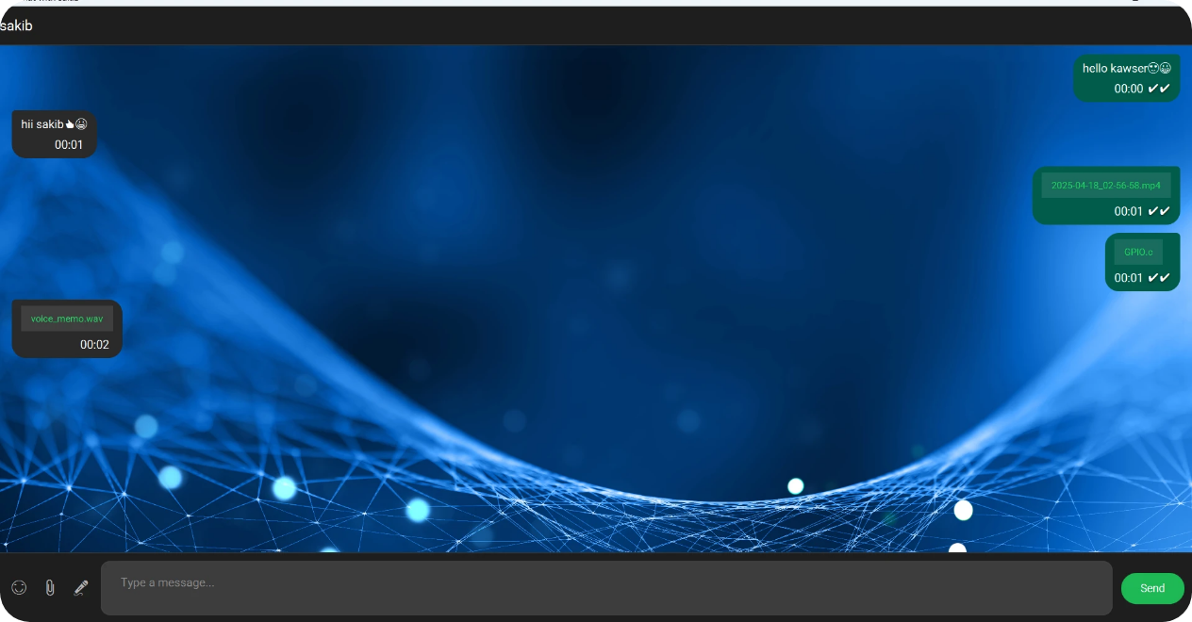
Private Chat
Private chat with message, voice, and file transfer with emoji support.

Slide 23
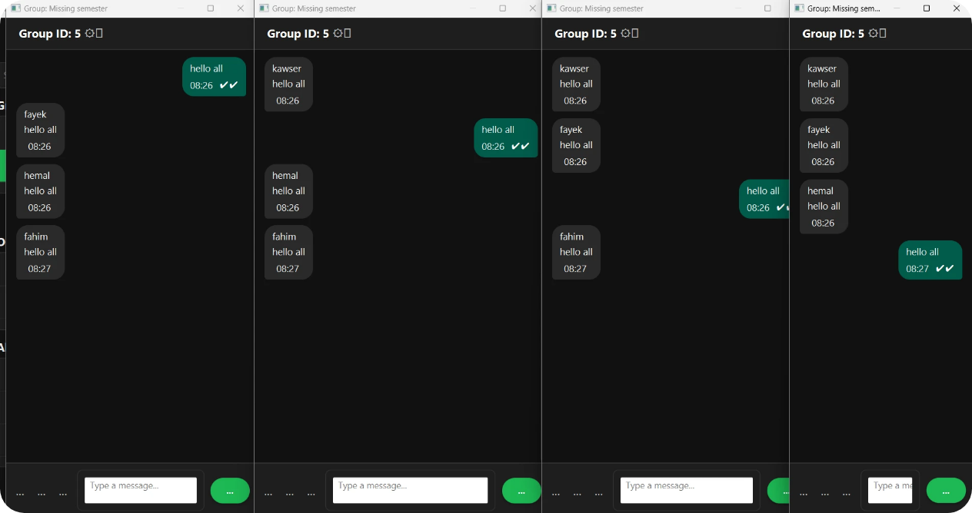
Group Chat
Group chat where users simultaneously send messages to the group.

Slide 24
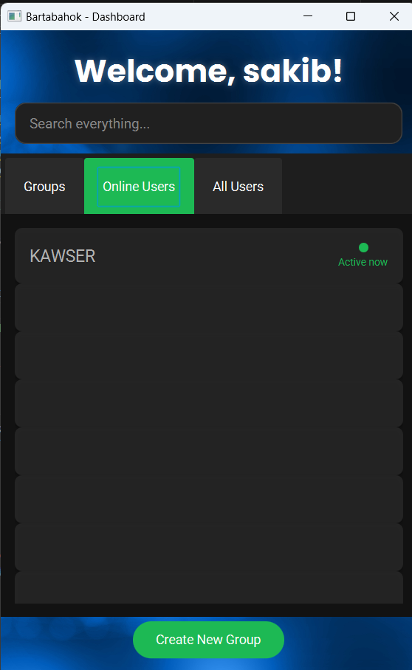
Online Users List

Slide 25
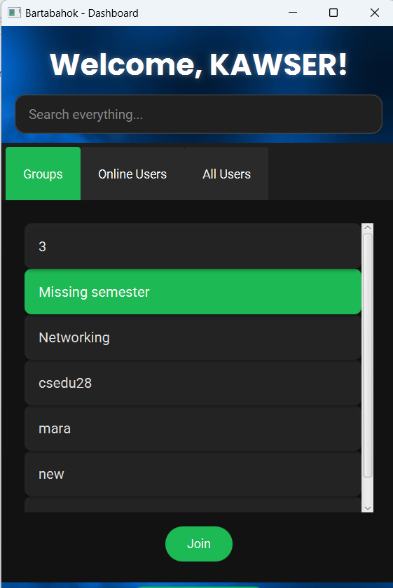
Join Group Option
Users can join to any group after double clicking on any group’s name.

Slide 26
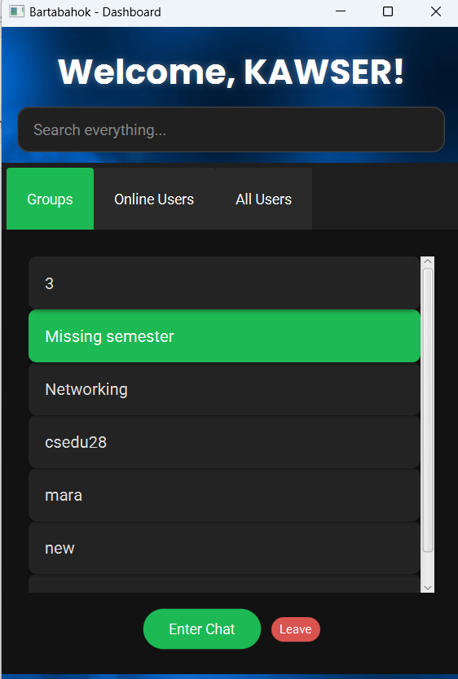
Enter group chat and leave option
After joining a particular group, enter group chat and leave group option will come to the user.

Slide 27
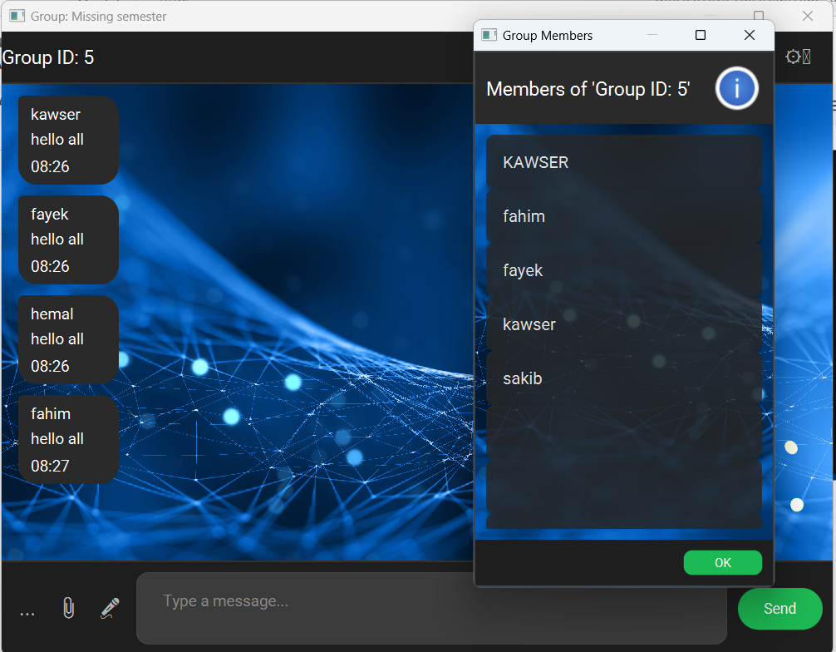
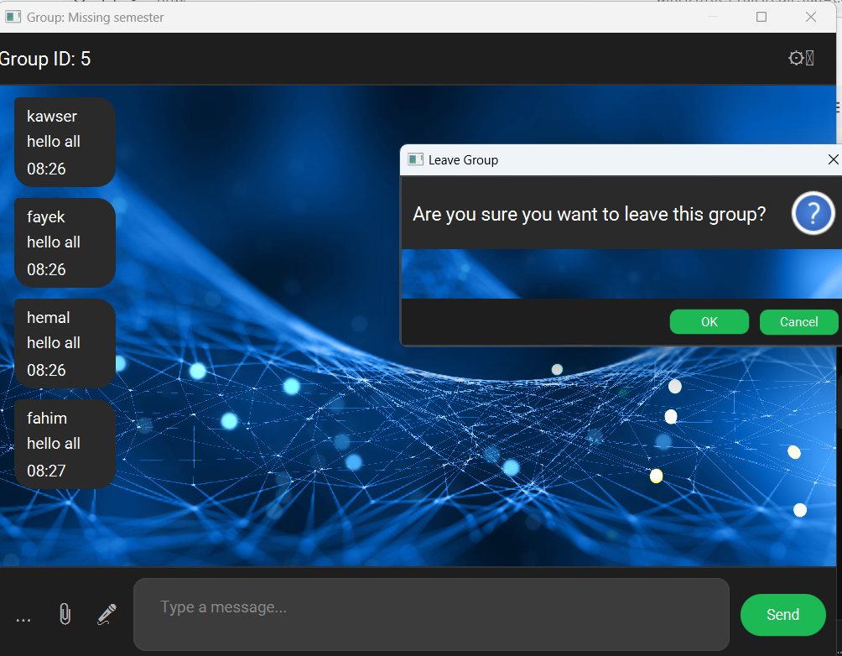
Group members and leave group option

Slide 28

08
Block Diagram/Work Flow Diagram

Slide 29
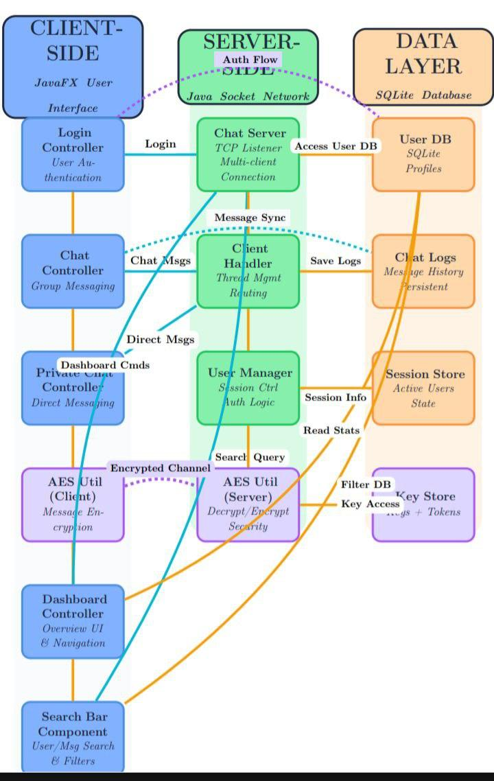
Block Diagram/Work Flow Diagram

Slide 30


09
Applied Networking Concepts with Corresponding Codes

Slide 31

Client-Server Architecture
The project follows a classic client-server model.
public class Server { private static final int PORT = 5000; private static final Map clients = new ConcurrentHashMap<>(); public static void main(String[] args) { try (ServerSocket serverSocket = new ServerSocket(PORT)) { while (true) { Socket socket = serverSocket.accept(); ClientHandler clientHandler = new ClientHandler(socket, clients); new Thread(clientHandler).start(); } } } }

Slide 32

Key Networking Concepts
1
Port Number (5000)
2
ServerSocket
The server listens on this well-defined port for incoming connections.
Java class that waits for requests to come in over the network.
3
Thread-per-Client
4
ConcurrentHashMap
Each client connection is handled in a separate thread for concurrent processing.
Thread-safe collection to store active client handlers.

Slide 33
Client Server Architecture
Socket Connection: Establishes TCP connection to server using hostname and
port
● Object Streams: Used for serialized Java object transmission
● Listener Thread: Dedicated thread for asynchronous message reception.
Message Protocol Design
Key networking concepts:
● Application Layer Protocol: Defines message types and structure for client-server
communication
● Serialization: Messages are serialized for network transmission
● Message Types: Different types for various application functions (authentication, chat,
file transfer)
● Reliability Mechanism: Includes ACK messages for message delivery confirmation

Slide 34
Reliable Message Delivery
Key networking concepts:
Retransmission Timer: Implements timeout-based retransmission (15 seconds)
Exponential Backoff: After initial retries, switches to fast retransmit
Positive Acknowledgment: Uses ACK messages to confirm delivery
Message ID: Unique identifier for tracking message delivery status
Congestion Control: Limits retransmission attempts (MAX_TOTAL_RETRIES = 10)

Slide 35
Group Communication
Key networking concepts:
Multicast Simulation: Server forwards messages to all group members
Reliability: Still uses ACK mechanism for group messages
Network Simulation: Randomly drops 20% of messages for testing
State Management: Maintains group membership lists in database

Slide 36
File Transfer Protocol
Key networking concepts:
Chunked Transfer: Files are split into chunks for transmission
Flow Control: Uses ACK mechanism for each chunk
Three-Way Handshake: REQUEST → (ACCEPT/REJECT) → CHUNKs
Network Simulation: Randomly drops 20% of chunks to test reliability

Slide 37
Network Simulation
Key networking concepts:
Packet Loss Simulation: 20% chance to drop messages/chunks
Testing Reliability: Ensures retransmission mechanisms work
Real-World Conditions: Mimics unreliable network behavior

Slide 38
Connection Management
Key networking concepts:
Connection Monitoring: Continuous listening for incoming messages
Graceful Shutdown: Proper resource cleanup on disconnect
Error Handling: Notifies application layer of disconnections
Thread Safety: Uses isRunning flag for controlled shutdown

Slide 39
Network Security
Key networking concepts:
Authentication: Username/password verification
Secure Transmission: Credentials sent over established connection
Session Management: Server maintains authenticated state

Slide 40
10
Limitations and Future Plans

Slide 41





Limitations and Future Plans
In-Memory Client Tracking
Performance Limitations
Database Design
Future Enhancements
• Problem: All messages in a single table, no indexing shown.
• Problem: Single-server state limits horizontal scaling.
• Problem: Java serialization is inefficient (large payloads, slow).
• Full encryption using AES or TLS sockets.
• Cross-device mobile app version (Flutter or Kotlin).
• Impact: Can't load balance across multiple servers.
• Impact: Performance degrades with large message history.
• Impact: Higher bandwidth usage and latency.
• Push notifications for offline messages.
• Voice/video calling via WebRTC.
• Admin-controlled chat rooms.

Slide 42
11
Conclusion

Slide 43

Conclusion
Bartabahok aims to be a fully-featured, fault-tolerant desktop chat application with strong user interactivity. Features like retransmission, concurrent messaging, voice communication, and emoji reactions enhance real-time collaboration. Tagging and group chat improve the messaging experience for teams or social use. With JavaFX and SQLite, this system is powerful yet lightweight — built with extensibility, user experience, and reliability in mind.

Slide 44

Thank You

